Slide 1

OHERA Health Care
Actuals and Forecast Analysis For Ohera Health
Prepared for: Executive Leadership
Prepared by: Nosen Indiamaowei
Date: January 2026

Slide 2

Ohera serves 1,200–1,800 patients monthly, differentiating itself through fast service delivery, in-house diagnostics, and integrated care, which significantly reduces referral delays and improves patient satisfaction.
However, its operating model is cost-intensive, with salaries, medical supplies, and rent accounting for over 60% of monthly expenses, making cashflow predictability critical for sustainability.

Slide 3
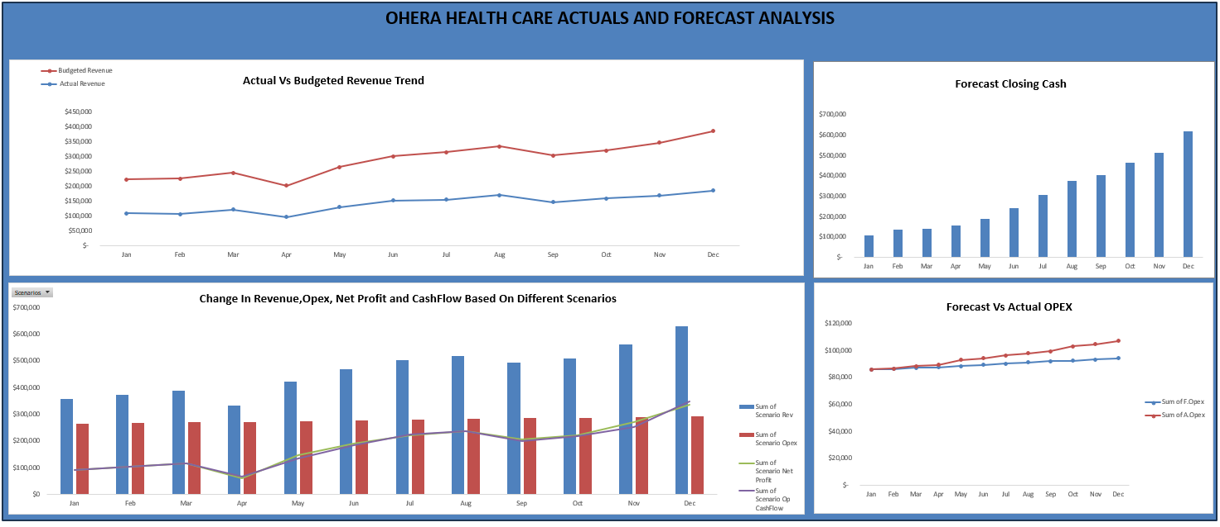

Slide 4

Executive Summary
Revenue trending upward but below budget expectations.
OPEX rising and consistently above forecast.
Cash position strengthens month-over-month.
Scenario analysis highlights opportunities for improved operating cash flow.

Slide 5
Actual vs Budgeted Revenue Trend
Budgeted revenue grows from ~$225K to ~$375K; actual revenue from ~$100K to ~$175K.
Actual revenue significantly lags budget.

Slide 6
Forecast Closing Cash
Cash increases from ~$100K to ~$700K.
Strong cash position despite revenue underperformance.

Slide 7
Forecast vs Actual OPEX
Actual OPEX exceeds forecast all year.
Rising cost pressures.

Slide 8
Scenario Analysis – Base Case
Scenario revenue increases; OPEX stable; operating cash flow improves.
• Top‑line momentum + stable cost base = expanding margins.
• Cash flow strength validates the quality of earnings.
• The April dip could signal a one‑time event or seasonality worth explaining in your narrative.
• Q4 surge is a highlight — ideal for emphasizing strategic wins or scenario upside.

Slide 9
Scenario Analysis – Worst Case
Revenue increases almost every month, with a pronounced jump in December.
This suggests either seasonality, scenario‑based uplift, or strategic initiatives paying off.
The widening gap between revenue and opex is the foundation of margin expansion.
The April dip is a point worth explaining — seasonality, one‑time events, or scenario assumptions.

Slide 10
Scenario Analysis – Best Case
Shows a clear upward trajectory from January to December.
• December stands out with a significant spike — likely seasonal or scenario‑driven.
• The consistent growth creates increasing separation from opex, which drives margin expansion.
• Net profit, Tracks closely with net profit, including the April dip.
• Strong upward movement from mid‑year through December.

Slide 11

Key Takeaways
Revenue underperformance is primary risk.
Cash position strong.
OPEX stability suggests effective cost control.
Revenue uplift improves cash flow.
Scenario modeling provides roadmap.

Slide 12

Recommendations
Strengthen revenue cycle management.
Implement cost-reduction initiatives.
Enhance forecasting accuracy.
Expand scenario planning.
Recommend scenario-based planning.
OPEX overspend must be addressed.

